Slide 1
Prediksi Harga Bitcoin Menggunakan Transformer Mengintegrasikan Harga, Sentimen, Tren, dan Volume dalam Analisis Deret Waktu Multivariat
Gilang Islamay Putra Djuharis
11190940000055
(Soon to be S.Mat)

Slide 2
Main Ideas
01
02
Sentiment Analysis
Time Series Forecasting

Slide 3
Past Research
Forecasting (Q1)
Big Data and Cognitive Computing (Q1)
On Forecasting Cryptocurrency Prices: A Comparison of Machine Learning, Deep Learning, and Ensembles
Predicting the Price of Bitcoin Using
Sentiment-Enriched Time Series Forecasting

Slide 4
Why Cryptocurrency?
Bitcoin | Ethereum | SOLANA | XRP | Cardano | Avalanche | Dogecoin

Slide 5

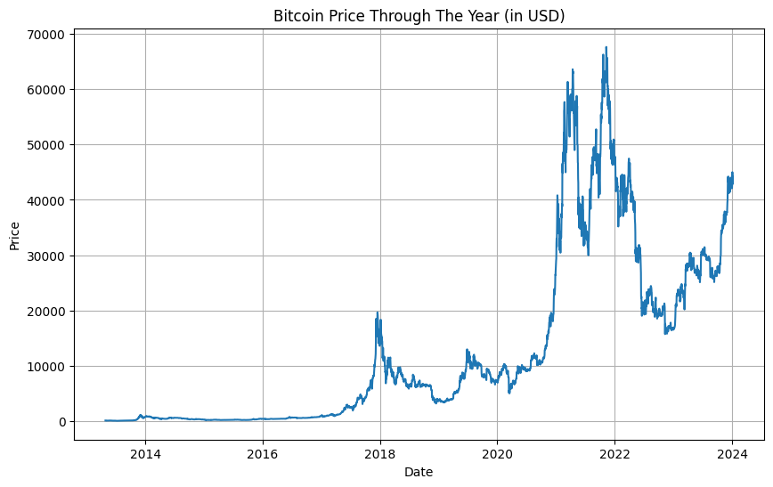
Price
This Price don’t Lie
(API coingecko.com)

Slide 6
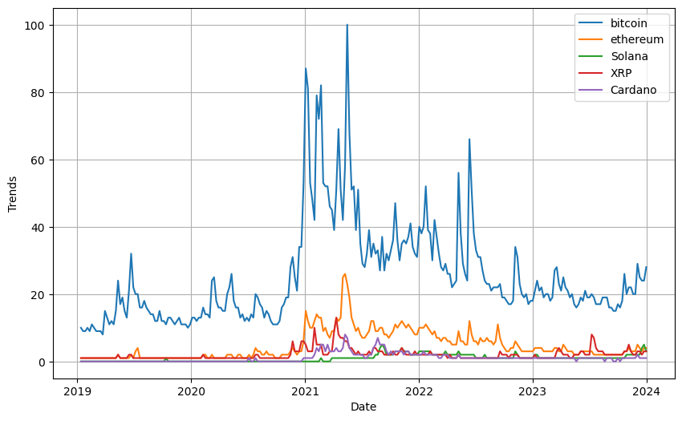
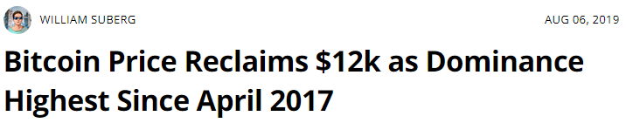
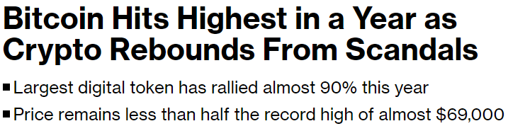
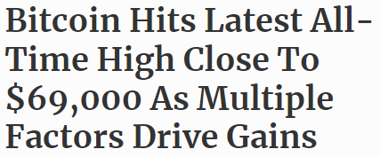
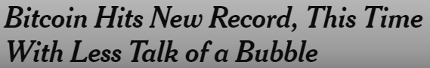
Popularity
(cointelegraph.com, 2019)
(bloomberg.com, 2023)
(forbes.com, 2021)
(nytimes.com, 2020)
(trends.google.com)

Slide 7

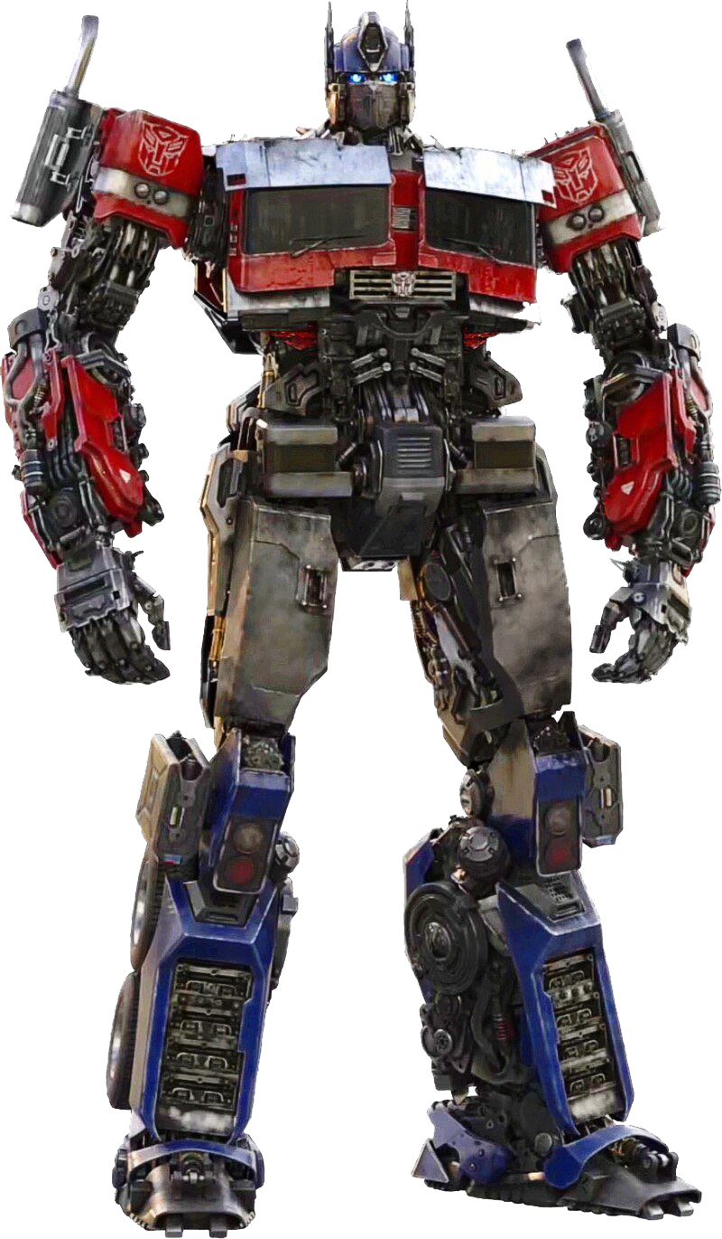
How?
By paying attention!

Slide 8
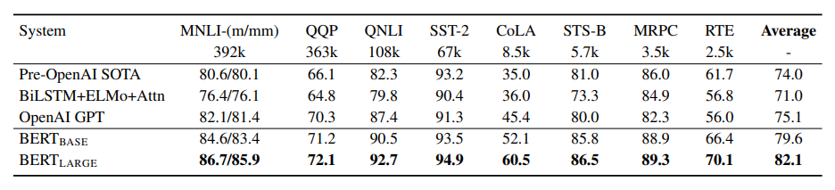
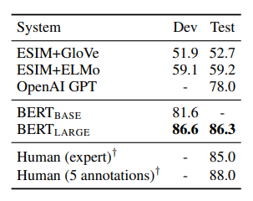
Bert

Slide 9
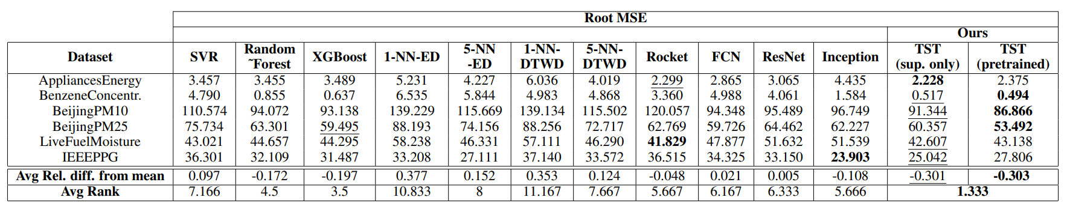
Transformer for Time-Series

Slide 10
Research Path
Prapemrosesan Data Teks
Membangun Model Analisis Sentimen
Prapemrosesan Data Seri Waktu
Pelabelan Manual Data Teks dan Augmentasi
Pelabelan Data Teks Menggunakan Model
Membangun Model Peramalan Seri Waktu

Slide 11
Analisis Sentimen
01
Current Objective:
Membangun model klasifikasi
sentimen terhadap topik Bitcoin

Slide 12
Prapemrosesan Data Teks
Penghapusan URLS dan Entitas HTML
01
02
03
04
05
06
Penyelarasan
Huruf Kecil
Tokenisasi
Penghapusan Tanda Baca dan Kata - Kata Penghubung
Penghapusan Karakter Spesial dan Angka
Lematisasi

Slide 13
Spam Tweet
date | Text
2021-07-03 20:53:51 | The $BTC price is at $34655.23 right now. 🔴 Compared to the last tweet, the price has dropped by $72.77 (-0.21%). 🟢 In the last 24 hours the price has increased by $1488.36 (4.49%). #Bitcoin #BTC https://t.co/5wDhcU31UB
2021-10-19 09:16:20 | 🐳🚨 Bitcoin Whale Alert: [ TX: 6e2f93751abd08b63306d5351da016187927ac712f442d6709d23d10b01e83c8 ]-[ ADDR: 1DuhtLa8TtCC547WfSNLHZvT91b9PQQeDD ]-[ #BTC: 16.68212472 ]-[ BLOCK_DATE: 2021-10-19 10:37:49 ] #btc_whale_alert #bitcoin- BTC_Whale_Alert
2021-06-21 07:43:39 | WhaleTrades: 📈💰$2,500,000 #bitcoin LONGED @$32,805.8359 [21/06/21 07:34:55] 🏤BitMEX | $XBTUSD 💬I’d take a fast nickel over a slow dime - buyerofblood
2022-04-16 15:59:12 | 💰 Market Cap. Swap 💰 What would one #Ecash $XEC cost if it had the market capitalization of #Bitcoin $BTC? One #XEC would be worth $0.0401409. 🤑 💪 🚀 | 👁️ More: https://t.co/fSCkKGmhcK… https://t.co/rmygNBMIhr

Slide 14
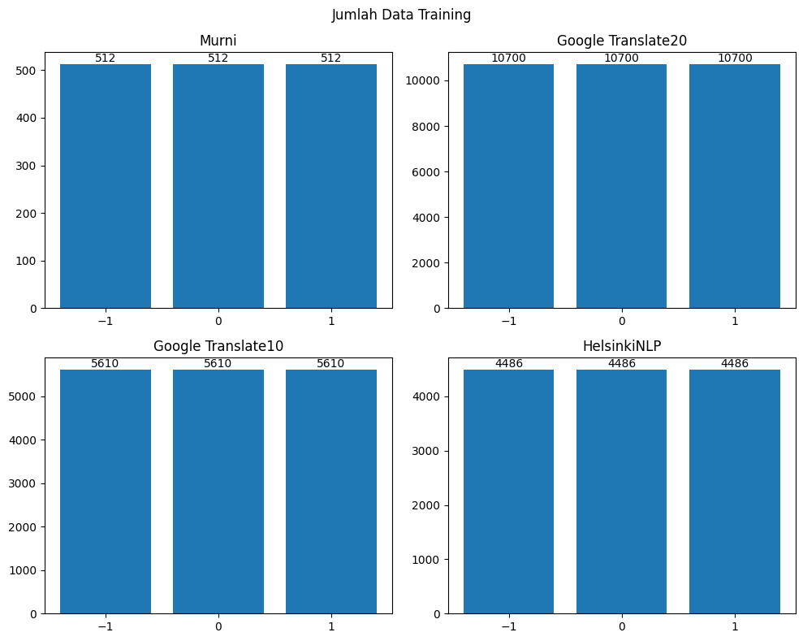
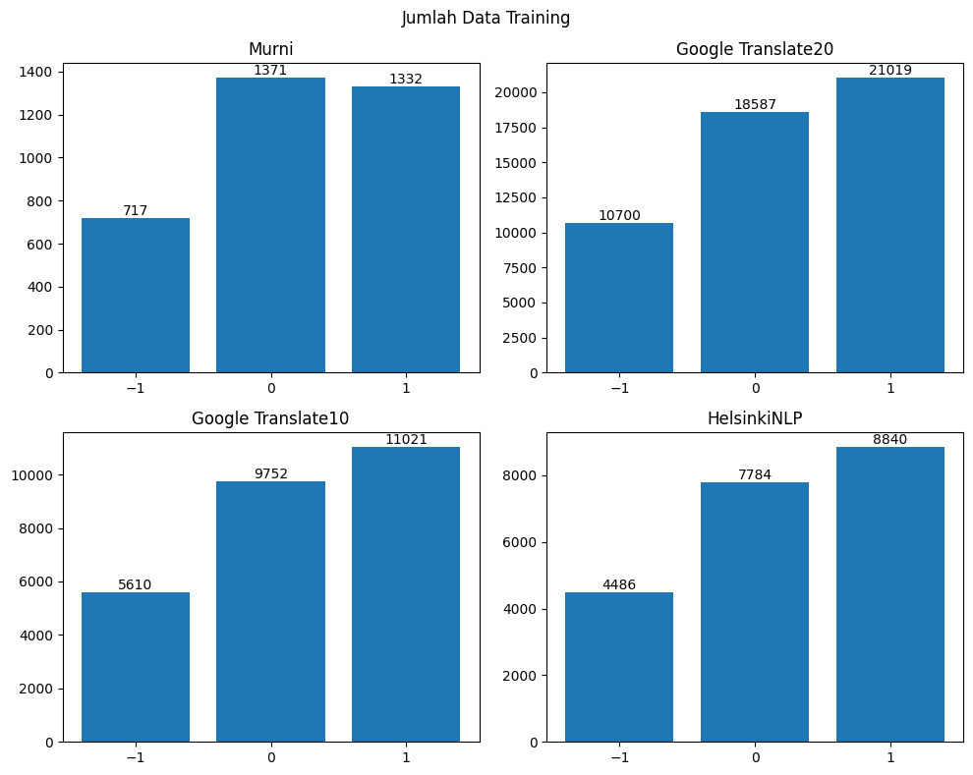
Pelabelan Data Teks dan Augmentasi
Google Translate20
Google Translate10
Top 20 Skor BLEU Tertinggi di Google Translate
Top 10 Skor BLEU Tertinggi di Google Translate
HelsinkiNLP
Model Translasi dari Universitas Helsinki

Slide 15
Membangun Model Analisis Sentimen
Model | Acc Negative Sentiment | Acc Neutral Sentiment | Acc Positive Sentiment | Overall Accuracy
twitter-roberta-base-sentiment-latest | 0,59 | 0,72 | 0,27 | 0,526666667
bertweet-base-sentiment-analysis | 0,53 | 0,75 | 0,24 | 0,506666667
finbert | 0,05 | 0,06 | 0,91 | 0,34
twitter-xlm-roberta-base-sentiment | 0,52 | 0,7 | 0,3 | 0,506666667
cryptobert | 0,37 | 0,56 | 0,59 | 0,506666667
twitter-xlm-roberta-bitcoin-sentiment | 0,47 | 0,51 | 0,38 | 0,453333333

Slide 16
Fine Tuned
Model | Before Fine Tuning | Murni | GT | GTH | T | Improvement
bertweet-base-sentiment-analysis | 0,5066667 | 0.626667 | 0. 666666 | 0. 666666 | 0.656667 | +31.62%
Cryptobert | 0,5066667 | 0.666666 | 0.673333 | 0.676667 | 0.646667 | +33.60%
twitter-roberta-base-sentiment-latest | 0,5266667 | 0.653333 | 0.65 | 0.646667 | 0.64 | +24.14%
twitter-xlm-roberta-base-sentiment | 0,5066667 | 0.606667 | 0.596667 | 0.616667 | 0.62 | +22.53%

Slide 17
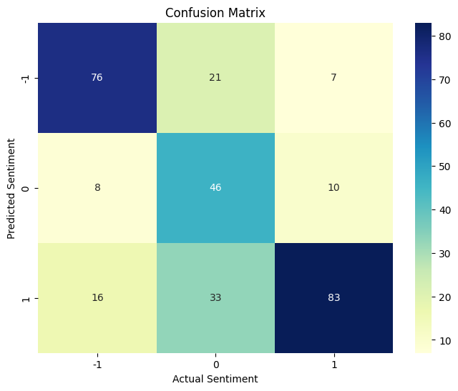

Introducing CryptobertRefined
Sentiment Score | Precision | Recall | F1-Score | n
-1 | 0,73 | 0,76 | 0,75 | 100
0 | 0,72 | 0,48 | 0,56 | 100
1 | 0,63 | 0,83 | 0,72 | 100
Accuracy | 0,68 |  |  | 300
Macro Avg | 0,69 | 0,68 | 0,67 | 300
Weighted Avg | 0,69 | 0,68 | 0,67 | 300

Slide 18
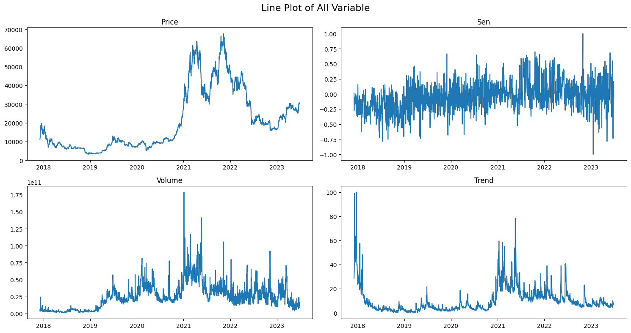
Pelabelan Data Teks Menggunakan Model

Slide 19
Awesome words

